Slide 1
PDGAN Additional Information
Parkinson’s Disease Background

Slide 2
What is Parkinson’s Disease?
Parkinson’s Disease is the second most common neurodegenerative disorder.
Affects Movement and Memory
There is no cure but symptoms can be treated if detected in early stage
Typically starts with an undetectable tremor, but if detected late, Parkinson’s Disease is unable to be treated

Slide 3
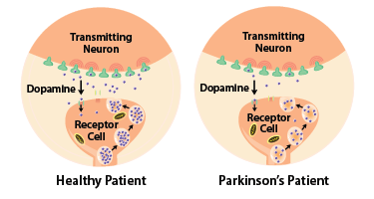
Causes of Parkinson’s Disease
Parkinson’s Disease is caused by a loss of dopamine production.
When dopamine levels decrease, it causes abnormal brain activity, leading to symptoms of Parkinson's disease.

Slide 4
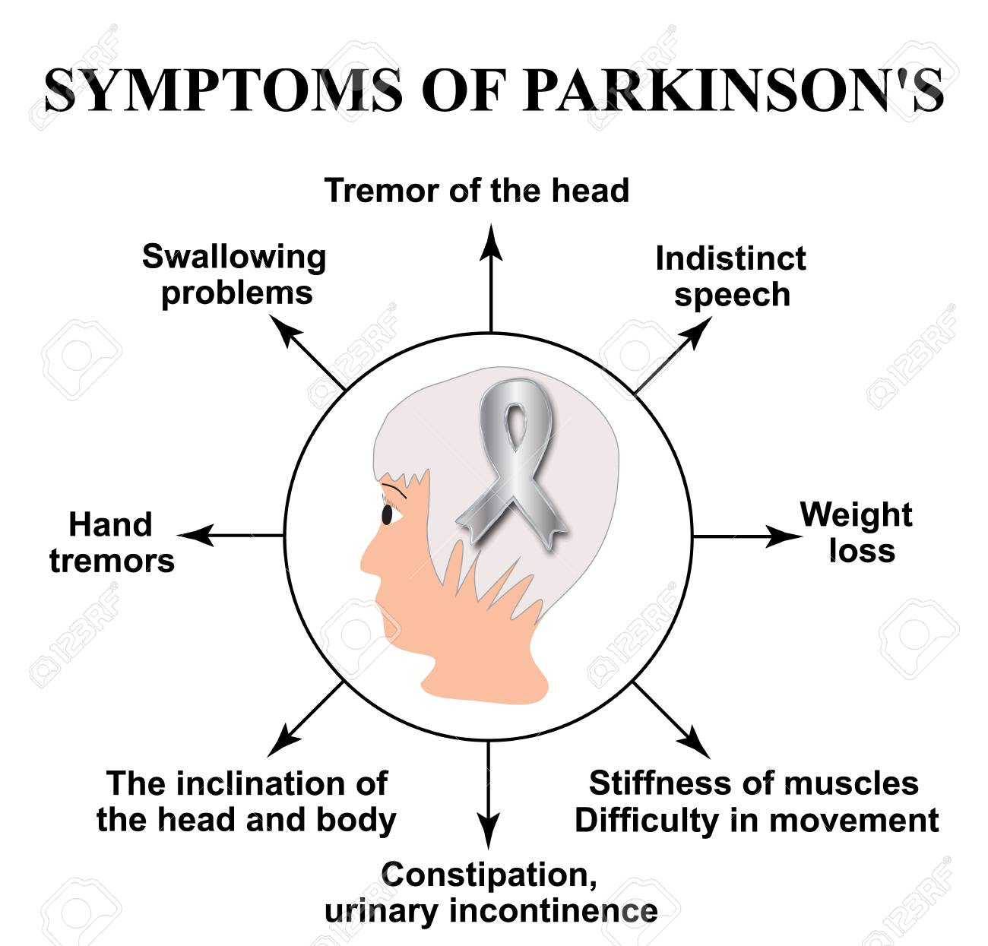
Symptoms of Parkinson’s Disease
Symptoms of Parkinson’s Disease include:
Tremors
Bradykinesia (Slowed Movement)
Speech & Writing Changes
Impaired Posture and Balance
Many of these symptoms may seem common, but could indicate bigger problems like Parkinson’s.

Slide 5
Medication
There are many medications to mitigate the symptoms of Parkinson’s Disease.
Levodopa is a chemical that converts to dopamine when it passes into the brain.
Dopamine agonists mimic dopamine in the brain. Not as strong as Levodopa, agonists lose their potency slower.
COMT inhibitors prolongs the effects of levodopa by blocking enzymes that break down dopamine.

Slide 6
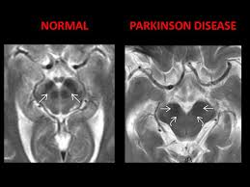
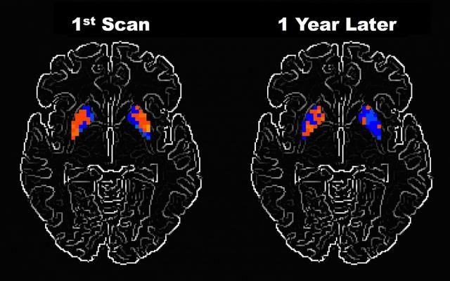
MRI’s Use in Parkinson’s Disease
Many researchers hypothesized the use of anatomical and functional MRIs to detect Parkinson’s Disease before symptoms develop.

Slide 7
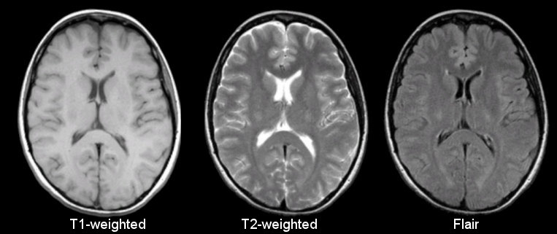
Types of MRIs
Each MRI has a different use
PPMI Dataset contained T2-weighted MRI scans (some were T2-Flair)

